Slide 1

Working Mathematically and how the brain learns: Making Connections
How can working mathematically help students to retain the mathematical knowledge and skills they learn in classrooms?
We will
explore the interrelationship between working mathematically and how the brain learns
view examples of working mathematically tasks that have been used to help students make connections and develop critical thinking skills.
gain insights into the impact this can have on student learning
Angela D’Angelo

Slide 2

The working mathematically outcome
MAO-WM-01 Develops understanding and fluency in mathematics through exploring and connecting mathematical concepts, choosing and applying mathematical techniques to solve problems, and communicating their thinking and reasoning coherently and clearly.

Slide 3
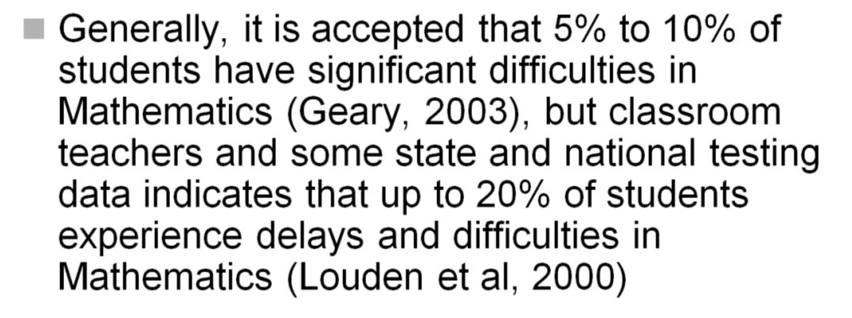
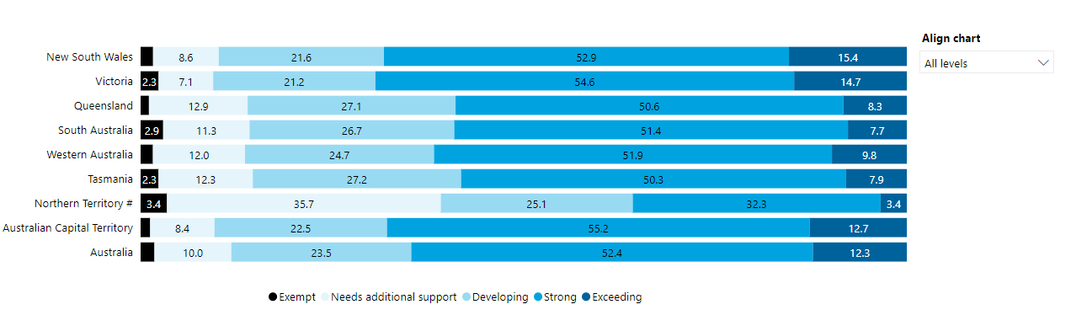
Do we have a problem with retention?
TIMSS
PISA
Many students are struggling to learn
2023 NAPLAN RESULTS

Slide 4

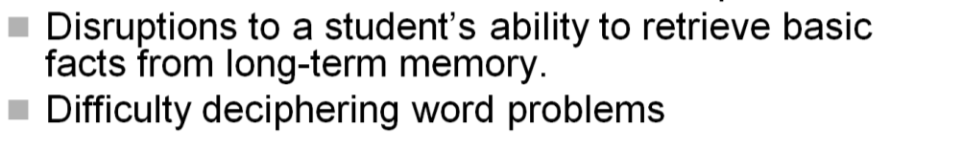
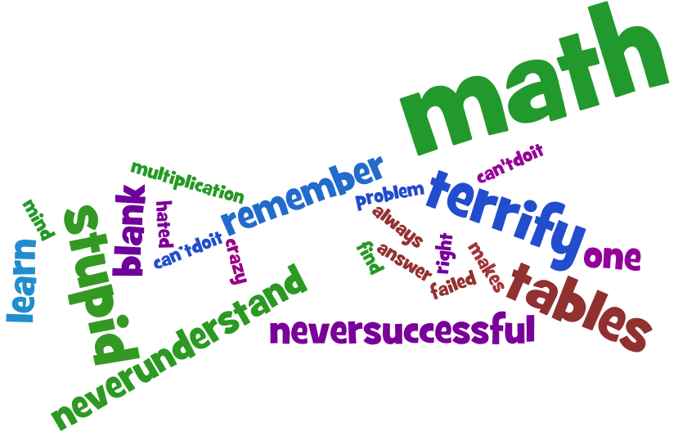

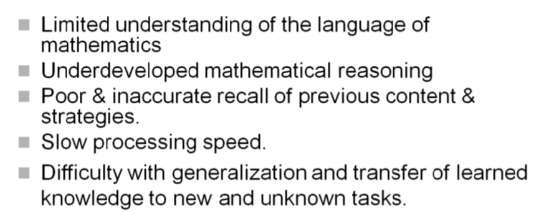
Maths Anxiety
The symptoms

Slide 5



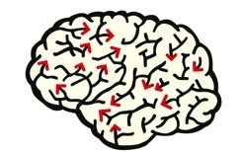

What can we do to alleviate maths anxiety and help with retention?
Learned helplessness
lack of success
Jonathan Groves
behavioral problems
Cortisol causes Shutdown
Notes:
Math anxiety causes the release of cortisol in the blood. Cortisol refocuses the frontal lobe to deal with the anxiety. Meanwhile any unrelated learning in working memory is disrupted and lost. Some causes of Maths Anxiety have been attributed to assessment, classroom culture, teacher attitudes and the curriculum. We will be looking at Instructional strategies and how they can be used to mitigate maths anxiety.
Johnathan Groves states “Teaching mathematics as meaningless, boring, uncreative garbage holds a lot of students back by making them think they are stupid in math. So they become self-fulfilling prophecies. They think that... there is no hope for them to learn, so their brains shut down. I believe their real problem is not that they are less intelligent ....... but that they suffer more from math anxiety and learned helplessness”

Slide 6


How should we teach for understanding
and transfer without causing maths anxiety?
can knowledge about how the brain learns help?
Notes:
Explicit teaching is very important in laying a foundation of factual knowledge and helping to create conceptual frameworks. Instruction provided by teachers should be explicit and detailed, providing students with worked examples to problems that they will face will reduce working memory load and facilitate transfer of the needed information to long-term memory. However it is ‘Working Mathematically’ that helps students make the necessary connections to assist deep learning, facilitate retrieval and help to develop critical thinking skills.

Slide 7

Judy Willis, MD,
Don’t start with the maths.....

Slide 8
The search for Novelty
The developing pre-adolescent brain responds to novelty.
In the onset of puberty during adolescent years the search for novelty becomes more intense.
Left Right
                Routine Novelty

Slide 9


Start with…
OR A PREDICTION this creates motivation to find out if we are correct...this encourages a "buy in"
a question…that inspires further ​examination
This arouses curiosity
Notes:
Millions of bits of information are detected by the brain every minute. The brain values change because it is the key to survival. Can it hurt me? Can it help my future survival?
survival

Slide 10



苦労 - Kurou
c
“hardship” and “labor.”
No struggle
Unproductive struggle
Productive Struggle
Students must struggle with an idea to create and strengthen circuits in the brain.
No pain – No neuroplastic gain.
Notes:
Japanese word for struggle. Teach through problem solving; often this is the weak area for most students. Hardship is an important part of learning. Repetitious and easy "busy work" does an injustice to their learning and can even cause stress.

Slide 11
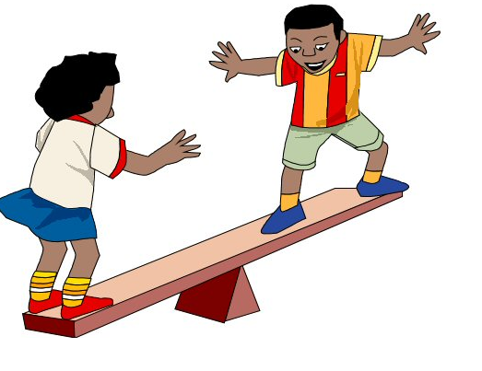
Getting the right balance
Mental Focus is the tool that changes and reorganises the brain
Challenging enough to demand effort
(high ceiling)
easy enough to expect success (low entry)
.
Notes:
This higher order thinking and analysis contributes to a deeper understanding of learning. Starratt (2004) maintains that this ​understanding is further enhanced by a relationship to the trajectory of students’ lives

Slide 12


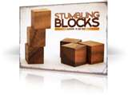

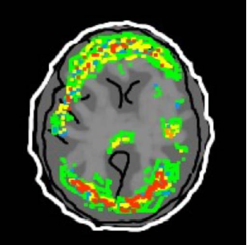
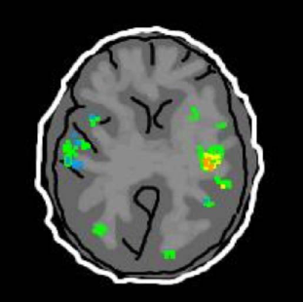
STRUGGLE
CREATION OF Neuro- PATHWAYS
AUTOMATICITY
(fluency)
Massed practice and spaced practice
UNBLOCKING
Brain maps contract but become extremely efficient.
John Pegg
Notes:
This is a scan of what a brain might look like after automaticity of a skill is acquired. There is a drastic reduction of activity in brain. Tools to solve problems are easily accessed and used without thinking.

Slide 13

THE POWER OF...
DOPAMINE
When two things happen together, they become linked in our minds.
“Neurones that fire together wire together"
Notes:
Dopamine Pathways. In the brain, dopamine plays an important role in the regulation of reward. When a problem that has required effort has been solved, Dopamine is released causing pleasure. Make learning challenging but successful, meaningful but fun! Neurones that fire together wire together.

Slide 14
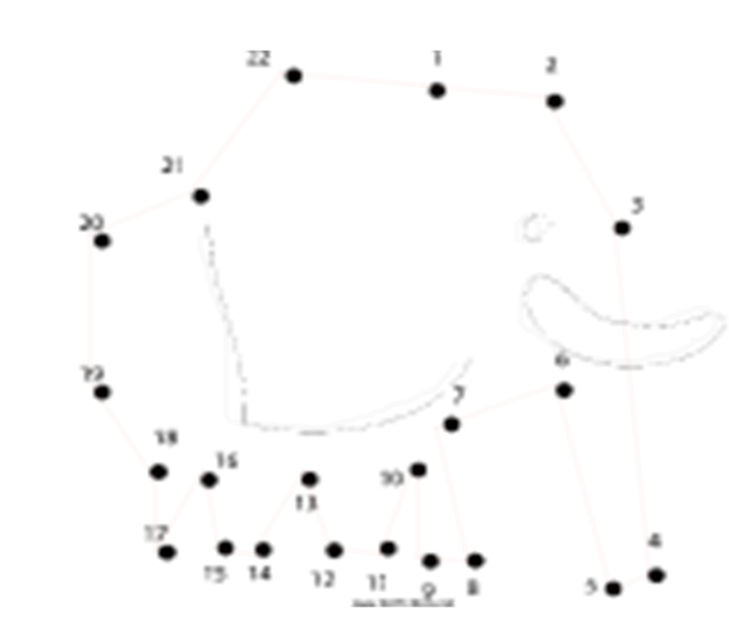
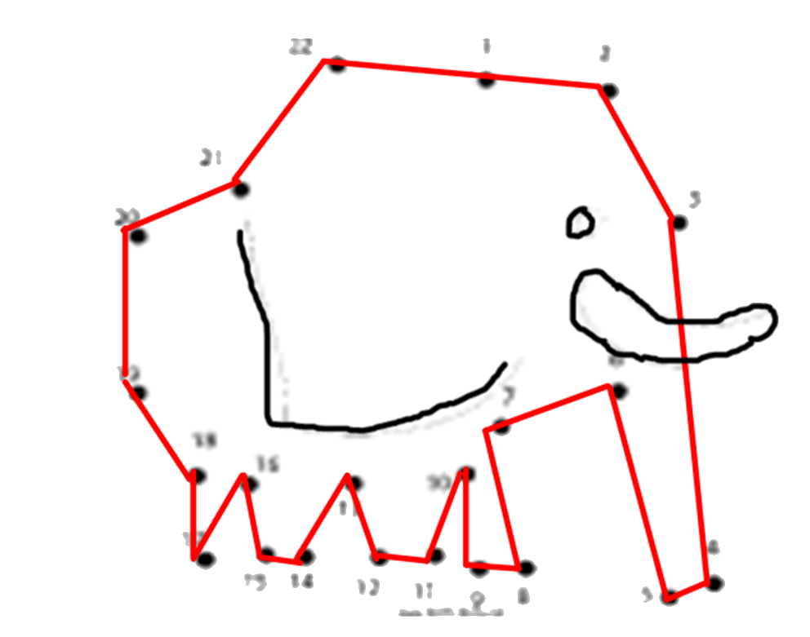
Students sometimes only see the dots we teach......
How can we help them connect the dots…… to prior learning ...to ​create understanding
and to see the big ideas
The eureka experience of connecting the dots is the most pleasurable part of learning it releases dopamine!
Notes:
What is obvious to us and where we are going is not obvious to the learner. We spend much time trying to impart facts and skills as quickly as possible in a hit or miss way. They need to be revealed or students need to be guided through the struggle to make the connections. We spend very little time helping them to create the big picture or join the dots, this requires hard work; There has been no time in a crowded curriculum (hopefully the new syllabus gives us the freedom now to spend this time for deeper learning.

Slide 15
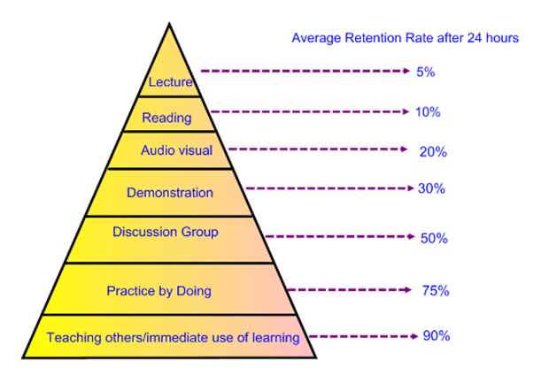
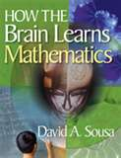

Notes:
David Sousa is another well known author on how the Brain leans Mathematics. If we look at the things that help retention they all lie within the sphere of WM actions, exploring , connecting , applying mathematical techniques and communicating.

Slide 16



Memory Systems
Incoming information from our senses
Short term memory
( two types)
Long term memory
(years)
Immediate
(seconds)
Working
(Minutes to days)
IS IMPORTANT
Preschoolers = about 2 items at once
Preadolescents = 3-7 items at once (5 -10 mins)
adolescents = 5-9 items at once (10 -20 mins)
Notes:
Working memory can handle only a few items at a time. Time indicates how long on average they can process an item intently before fatigue or boredom sets in. For focus to continue there must be a change in the way he/she is processing the item. When planning lessons…less is more, shorter is better, cognitive load should be reduced (chunking) Initial and secondary rehearsal. The learner needs sufficient TIME to attach sense or meaning beyond initial processing if it is to transfer to secondary rehearsal, otherwise new information will likely be lost. Review, elaboration, assignment of relevance will significantly enhance the chance of retention. Chunking is a term referring to the process of taking individual pieces of information (chunks) and grouping them into larger units(that are connected o make sense together).
By grouping each piece into a larger whole, you can improve the amount of information you can remember.

Slide 17
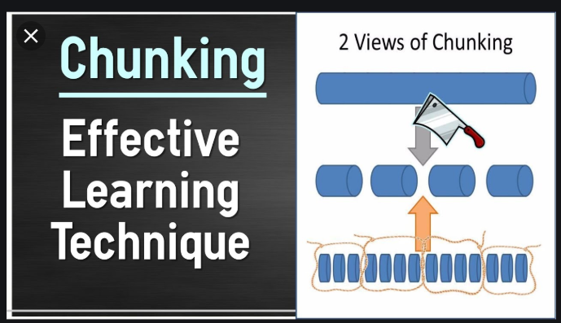
CHUNKING-STM
Chunking is a term referring to the process of taking individual pieces of information (chunks) and grouping them into larger units(that are connected o make sense together).
By grouping each piece into a larger whole, you can improve the amount of information you can remember. Recall of information is greater when the "chunking" strategy is used. A chunk can then be defined as "a collection of elements having strong associations with one another.”

Slide 18


Chunks-Example

Slide 19
DUAL CODE Theory (DCT)
This was established and developed by Allan Paivio (Paivio 1986, Clark & Paivio 1991, Mayer & Moreno, 1998).
The theory states that the working memory has two distinct channels for processing information: verbal and non-verbal.
both sensory imagery (sound or image) and verbal information should be used to represent information for meaningful learning to occur. This ‘dual coding’ helps retention.
Notes:
Powerful images can help to represent problems, understand terms and so much more in working mathematically. Moreover students should always be encouraged to draw diagrams when working mathematically.

Slide 20
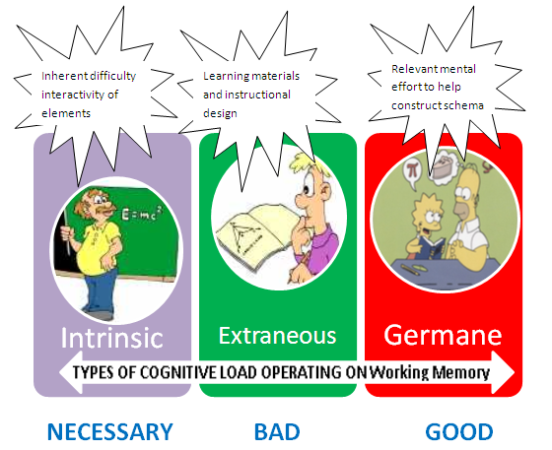
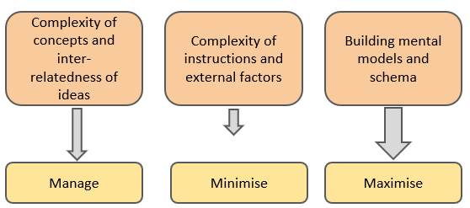
TYPES OF COGNITIVE LOAD
Article
Notes:
CLT reinforces the importance of ‘struggle/effort ‘germane’ CL and intrinsic CL (e.g. X2 maths) but warns against unnecessary hurdle for students when solving problems.

Slide 21
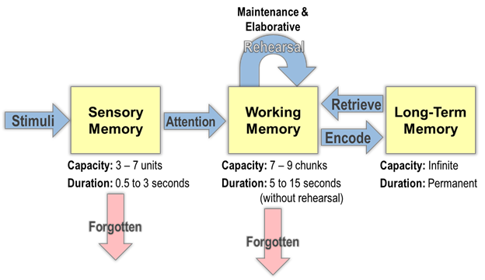
Elaborate Rehearsal
Used to reprocess and make connections to previous learning and assign meaning. When students get little time or training for elaborative rehearsal they resort to rote and consequently fail to make the important connections.
Strategies include paraphrasing, selecting critical information, predicting, questioning, explaining, summarising (note: these are all connected to the WM outcome)
Notes:
Keep the number of items within capacity limits of working memory. Less is more! Keep within the time limits of working memory and students will stay focused and remember ….shorter is better!

Slide 22
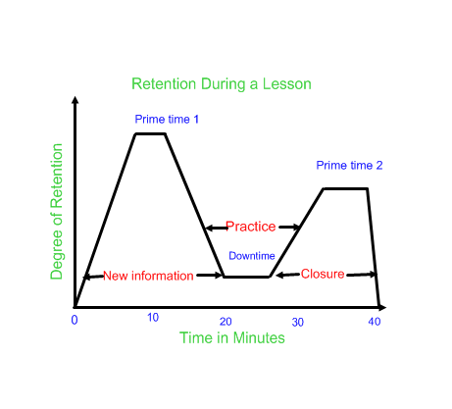
When should new learning be presented in a Lesson? The primacy- recency effect
David Sousa
Notes:
Take into account the primacy-recency effect.. Supporting the ‘hook’ at the start of the lesson along with processing of new information, importance of consolidation and massed practice and of cognitive closure where an opportunity to develop metacognition emerges in making students reflective.

Slide 23
Spacing Effect
Discovered in the 1800s. If learning is spaced with rest periods between learning episodes, it is superior when compared with the same learning time massed without rest periods.
John Sweller is now testing the hypothesis that working memory capacity depletes after heavy use and recovers after rest, which can potentially explain the spacing effect.
Notes:
This attests to the importance of massed AND SPACED practice.

Slide 24
Examples of WM Tasks that help to make connections to help retention
Novelty or Prediction
Productive struggle
MAO-WM-01 Develops understanding and fluency in mathematics through exploring and connecting mathematical concepts, choosing and applying mathematical techniques to solve problems, and communicating their thinking and reasoning coherently and clearly.
Communication and reasoning
Choosing and applying techniques
Exploring and making connections
Notes:
encourage thinking in different ways...presenting and fostering diverse methods of solution by immersion

Slide 25
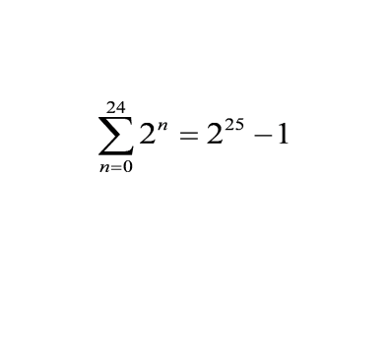


Activity 1
Novelty or Prediction
Taylor Swift is offering 2 types of show bags at her Sydney show …..
2
If you had a choice.......
would you choose
1. the showbag with $100 000 or
2. take the showbag with the amount calculated as ... 1^{c} for her first show this year, 2^{c} for her second...and so forth, keep doubling for the number of shows she has done until show 25 in Sydney.
Which would you take? Explain your reasoning.
Communication and reasoning
=$335 544.31
Exploring and making connections
How does this connect with the graph?

Slide 26

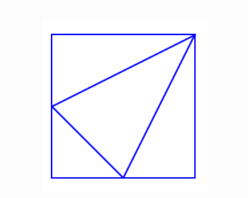
Activity 2
Novelty or Prediction
Productive struggle
I drew this picture by drawing a line from the top right corner of a square to the midpoint of each of the opposite sides. Then I joined these two midpoints with another line.
Can you see four triangles in the square?
What fraction of the area of the square is each of these triangles?
Explain how you reached your conclusion for each triangle.
Choosing and applying techniques
Similar resources
Courtesy M. Lees
Murderous maths (Catriona’s puzzles)
Mrbarton’s Maths

Slide 27
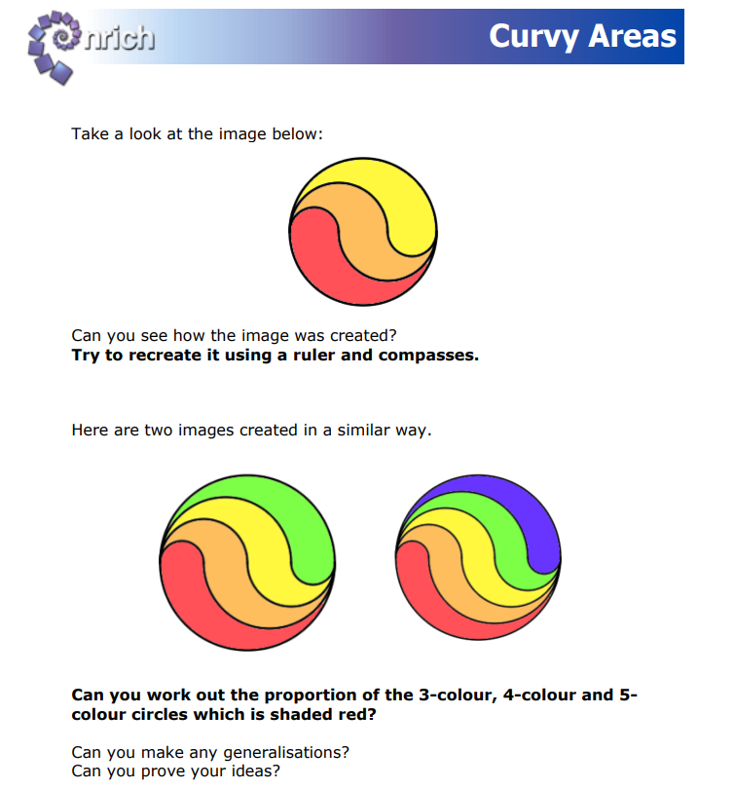
Novelty or Prediction
Choosing and applying techniques
Why do this problem?
This problem offers the opportunity to practise calculating areas of semicircles and working in terms of π and leads to a surprising result that invites students to generalise.
Productive struggle
Communication and reasoning

Slide 28
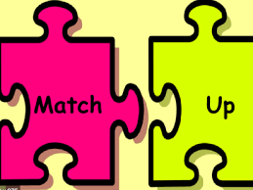
Help with elaborative rehearsal by making connections
Communication and reasoning
Productive struggle
Making connections

Slide 29
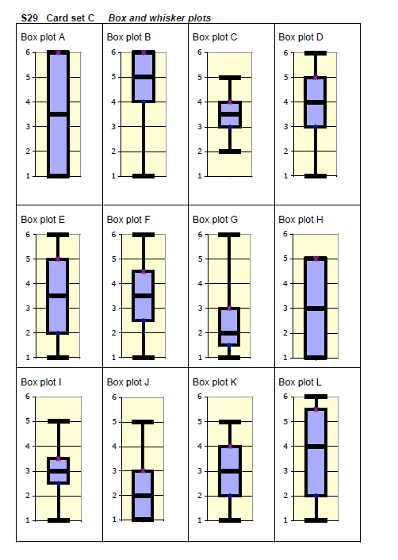
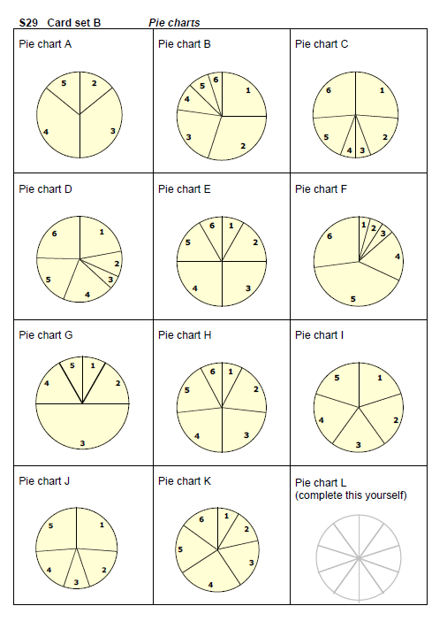
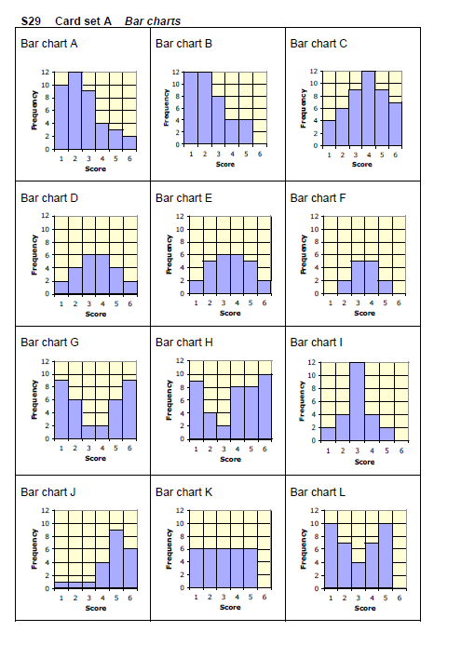
What is involved here?
Communication and reasoning
Productive struggle
Making connections

Slide 30
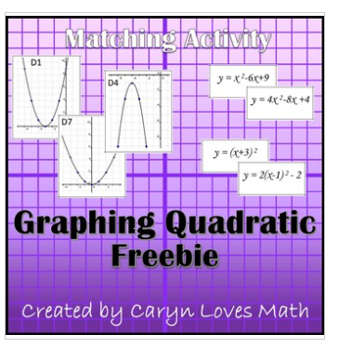
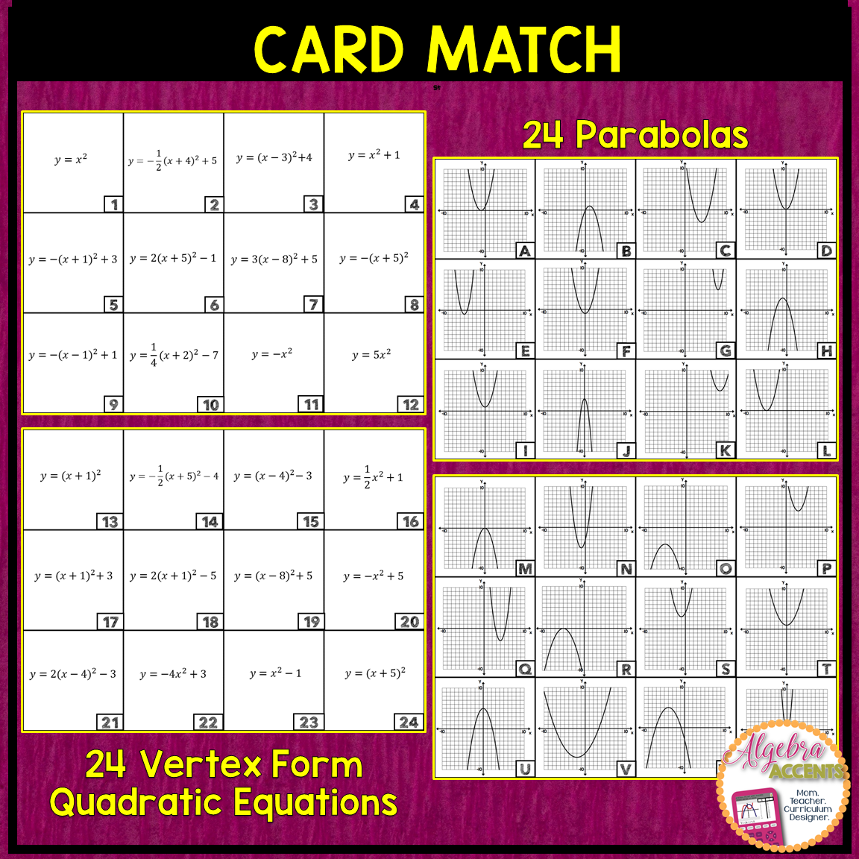
Justify your choice
Making connections
Communication and reasoning

Slide 31
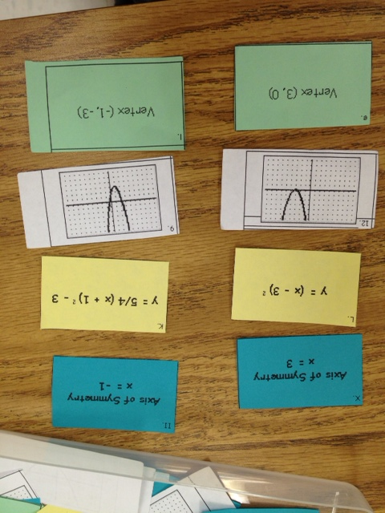
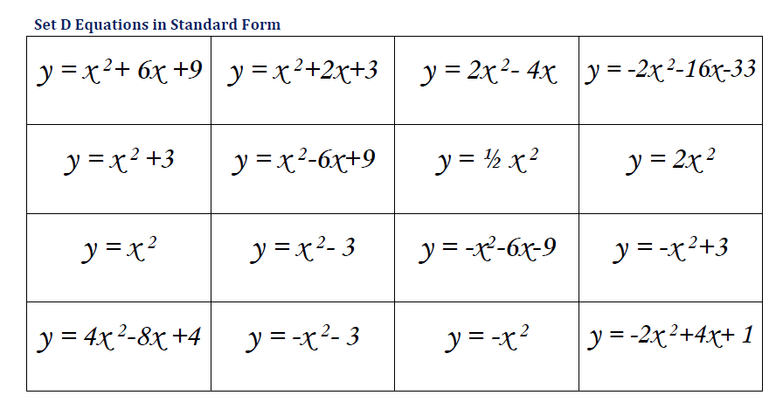
Vertex and Axis of Symmetry could be added as well as worded transformations from y=x^2

Slide 32

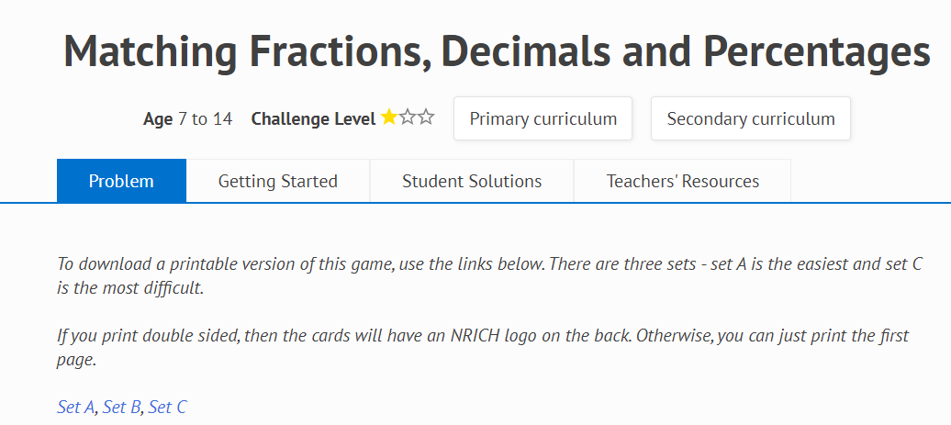
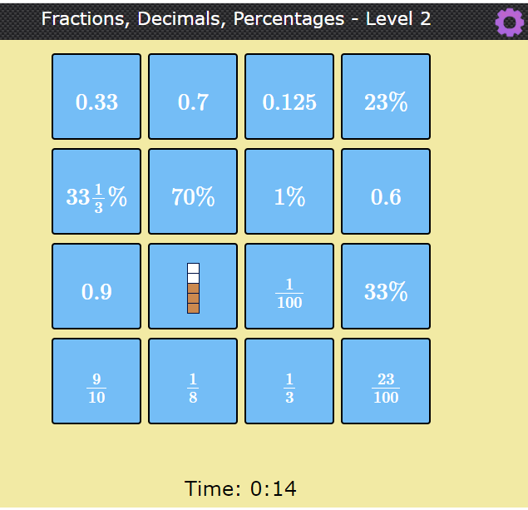
Creating AUTOMATICITY
is important!

Slide 33
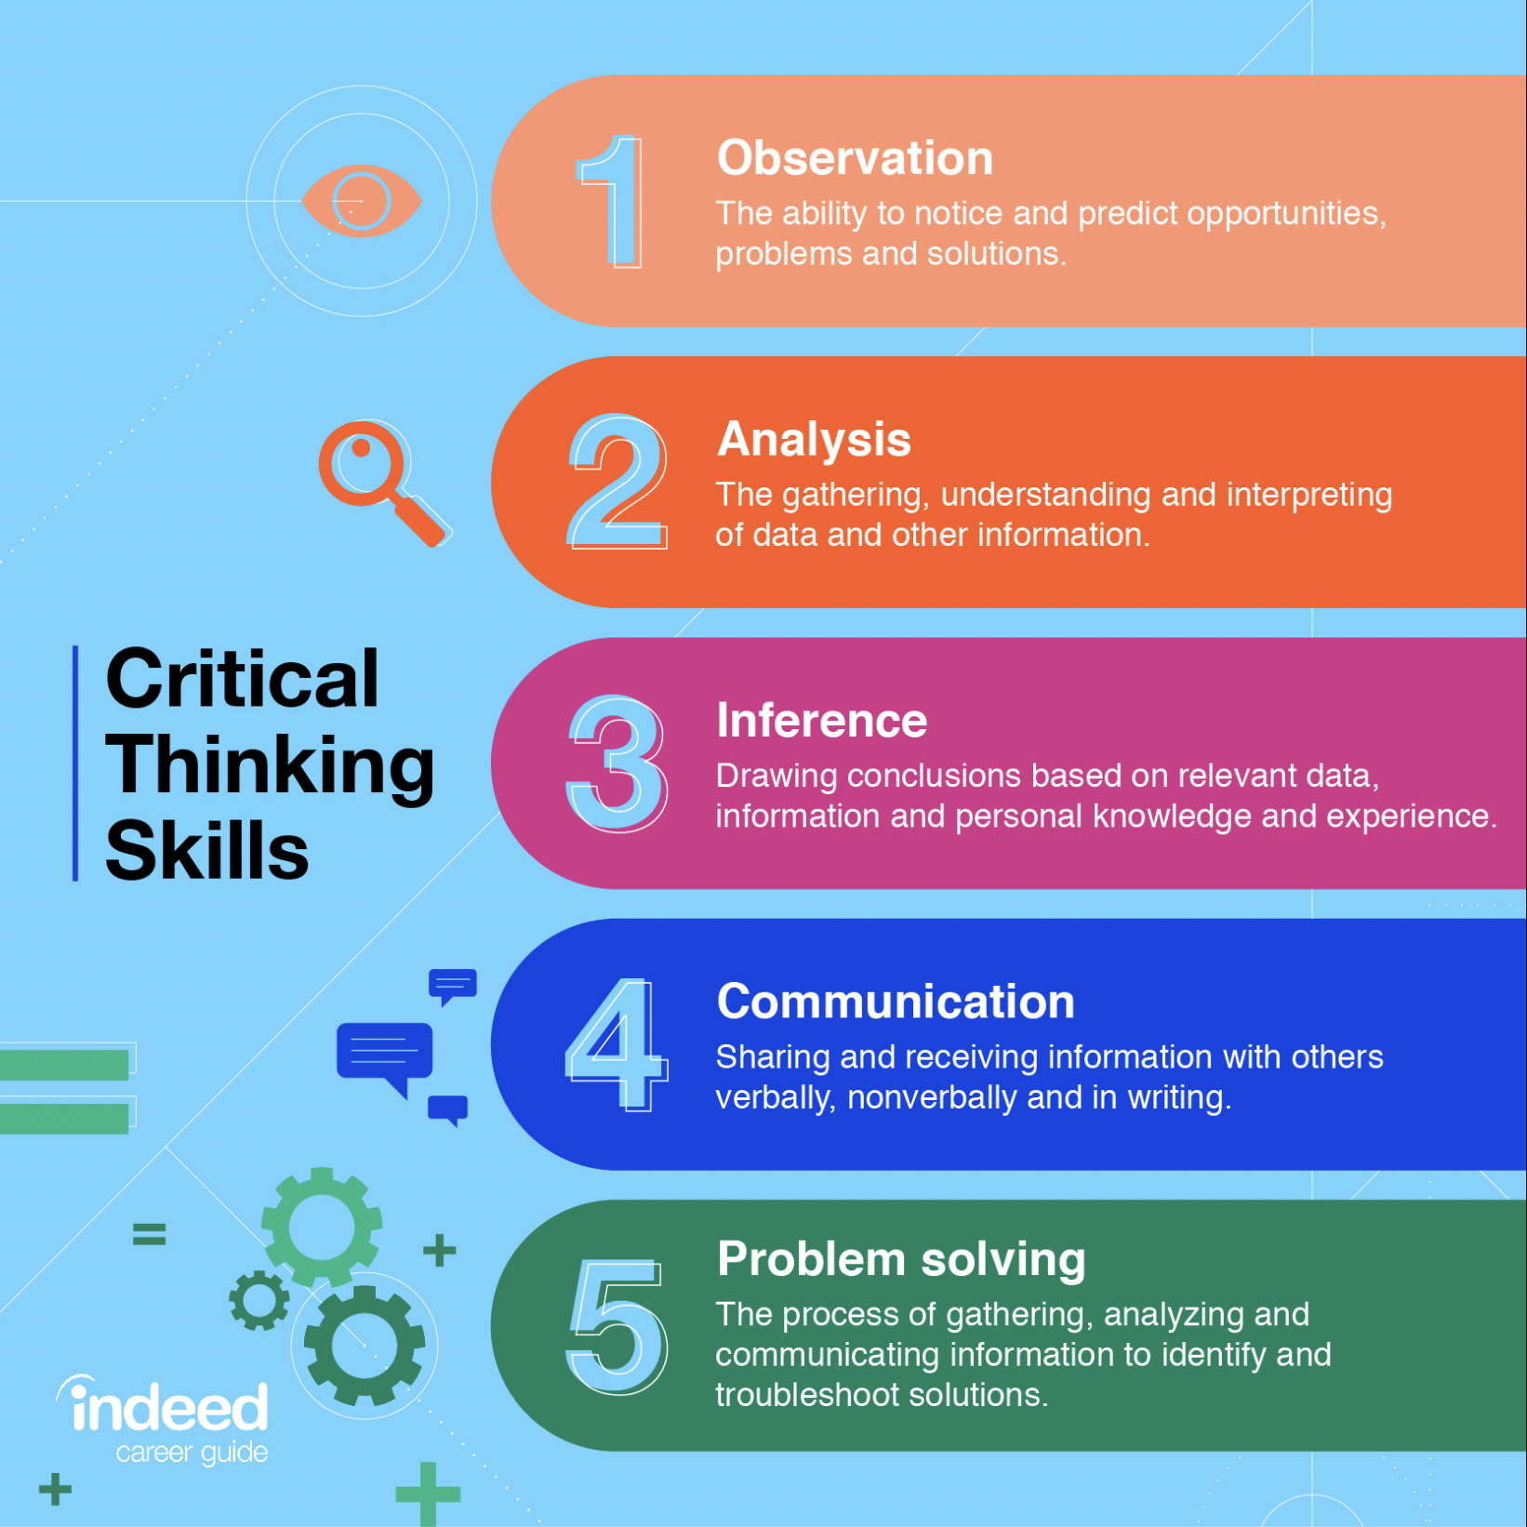
Notes:
Francesca Spissu and Louise MacDonald at Casimir Catholic College have used this critical thinking scaffold to design WM tasks for their students with great success!

Slide 34
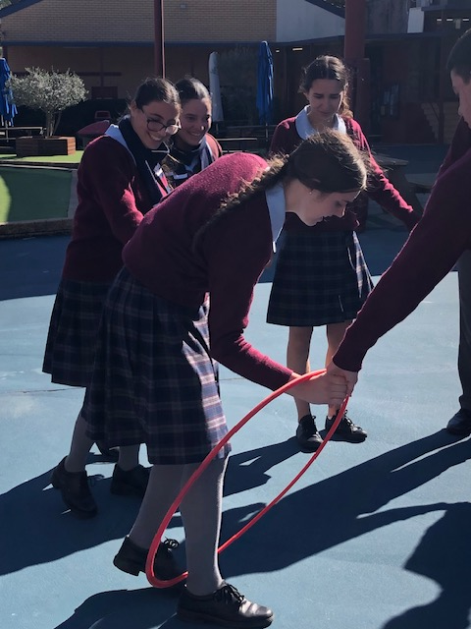
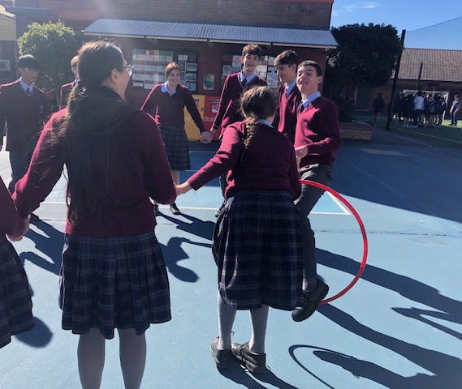
Novelty or Prediction
Making connections
Finding Correlation and Regression lines using practical data gathering.
Notes:
Students start from a small sized group (say 3) to increasingly larger groups (10) and record number of students vs time taken to complete transfer of hoola hoop. Is there are relationship/correlaton? Can you predict the type of relationship. Explicit teaching back in the classroom of getting the regression line electronically .What does it mean?

Slide 35
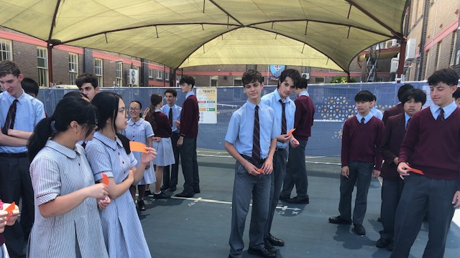
Novelty or Prediction
Making connections
helped by letting me see how other people saw a problem and other ways of seeing the questions - James
activities provided a unique way to learn a topic which was very helpful - Max
useful in understanding mathematical concepts in a more tangible, and physically interactive way.
Graphing exponentials by simulating a pandemic
Notes:
Students simulate a simple power of 2 pandemic, and record infections according to rounds. A table of values is then used to find the algebraic rule and graph. Part 2: what happens when immunity is introduced? Different coloured cards given to those with immunity. Can you predict what will happen?

Slide 36

Angela D’Angelo: adash49@hotmail.com

