Slide 1
Developing understanding and Fluency
a STRATEGIC balancing act!
Dr Christine Mae Mobile: 0433 700 946 Email: christinemae583@gmail.com

Slide 2
Balance the development of understanding and fluency
Working Mathematically describes the thinking and doing of Mathematics and the breadth of actions we need to emphasise when teaching Mathematics. This workshop will model how properties and principles that underpin algebraic reasoning develop from Stage 2 to Stage 4, and the role that understanding properties and principles plays in supporting fluency and flexibility with mental and written calculation strategies. In this workshop you will:
Identify important mathematical properties and principles in Number and Algebra and how they develop.
Recognise how and why properties and principles support fluency with flexible mental and written solution strategies.
How can we strategically balance and sequence teaching for understanding and fluency to build strong foundations at every level of schooling that will enable excellent ongoing progress?
Properties and Principles of Multiplicative Relations

Slide 3
Working mathematically: a continuous, overarching outcome
There is one continuous, overarching working mathematically outcome from K-10:
A student, develops understanding and fluency in mathematics through exploring and connecting mathematical concepts, choosing and applying mathematical techniques to solve problems, and communicating their thinking and reasoning coherently and clearly.
Do students understand the mathematics they are learning?
Are students connecting techniques to concepts?
Is sufficient experience provided for students to become fluent in choosing and applying techniques to solve problems?
Students need many experiences to relate their knowledge to the vocabulary and conceptual frameworks of mathematics.

Slide 4
understanding and fluency
Understanding involves making cognitive connections between new material or experience and existing ideas.
Conceptual understanding supports retention. Because facts and methods learnt with understanding are connected, they are easier to remember and use, and they can be reconstructed when forgotten.
Mathematical fluency is developed when students (Watson and Sullivan 2008):
choose and use appropriate strategies
carry out procedures flexibly, accurately and efficiently
recall factual knowledge and concepts to solve problems
use known facts, and reason about relationships to find solutions.
Understanding multiplicative properties and principles is an essential foundation for fluency in choosing and using appropriate calculation strategies – flexibly, accurately and efficiently!

Slide 5
Multiplicative properties and principles
What multiplicative properties and principles do students encounter and need to understand in Mathematics K-10?
In which Stage are they introduced? How do they build a foundation for the next stage of learning?
Equivalence

Slide 6
spatial foundations
Rotating a rectangle does not change its name or its size.
=
If we divide one dimension of a rectangle, and multiply the other dimension by the same number, the area stays the same.
=
The area of a shape does not change when it is split and recombined.
=
+
Conserving and transforming space in Stage 1are foundations for understanding properties of multiplication.

Slide 7
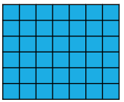
Introducing Properties of multiplication
We can change the order of the factors without changing the product (Introduced in Stage 1 and modelled and applied in Stage 2).
6 x 7 = 7 x 6
We can use factors to rearrange and regroup numbers when multiplying without changing the product (Introduced, modelled and applied in Stage 2).
6 x 7 = 2 x (3 x 7) or 2 x 21
We can partition numbers, multiply each part separately and then combine the products (Introduced, modelled and applied in Stage 2).
6 x 7 = 6 x (6 + 1) or 36 + 6
6 x 7 = 6 x (5 + 2) or 30 + 12
6 x 7 = 6 x (4 + 3) or 24 + 18
7 x 6 = 7 x (5 + 1) or 35 + 7
7 x 6 = 7 x (4 + 2) or 28 + 14
7 x 6 = 7 x (3 + 3) or 21 + 21

Slide 8
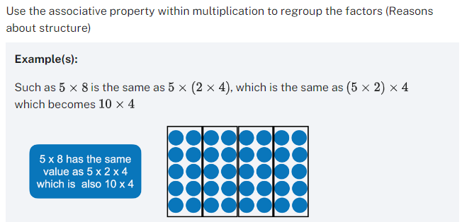
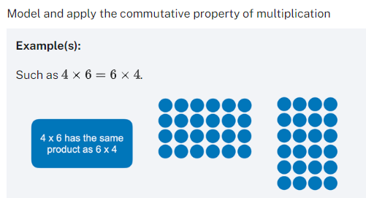
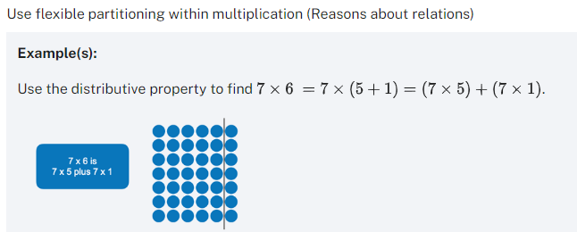
Understanding AND FLUENCY By the end of Stage 2 …
develops understanding and fluency in mathematics through exploring and connecting…
In how many ways can 5 x 12 be partitioned, regrouped or rearranged to find the product?
Which way is most efficient?
Why can we get the same answer in so many different ways?

Slide 9
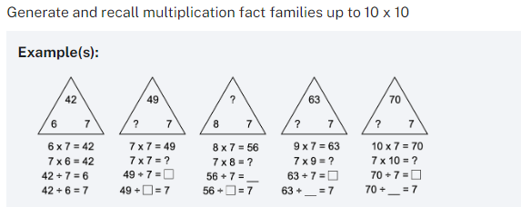
Developing fluency in Stage 2
In Stage 2 understanding and fluency with the Commutative, Associative and Distributive properties is developed. Students model and apply the properties numerically in the context of learning how to use known facts to establish unknown facts. Through this process students generate and learn to recall multiplication fact families to 10 x 10.
Teach students to use the Associative property to multiply multiples of 10 by single digit numbers.
For example, 7 x 60 = 7 x (6 x 10) which is the same as (7 x 6) x 10, or 42 tens. It is 420.
*It does not mean multiply 7 x 6 and ‘add a zero’!
Associative and distributive properties both applied

Slide 10
Understanding and Fluency by the end of stage 2
*Know and readily recall multiplication and related division facts to 10 x 10.
Understand properties of multiplication and how to apply them to establish unknown facts.
Recognise and use the distributive property to identify an unknown number and reason why.
5 x 7 = 5 x 5 + 5 x ?
8 x 9 = 8 x 10 - ?
Identify relationships to write equivalent expressions and complete number sentences.
15 x 8 = 30 x ?
12 x 3 = ? x 6
Recognise when and how to factorise and use the Associative property as a mental strategy to find an unknown fact.
5 x 12 =?
Use place value, factorisation and the Associative property to multiply single digit numbers by multiples of 10.
6 x 40 = ?
5 x 50 = 5 x 5 x ?
7 x ? = 210
LANGUAGE, LANGUAGE, LANGUAGE
Rename, regroup, rearrange

Slide 11
Properties of PLACE value: An essential foundation
Understanding properties of place value and fluency in applying them to represent numbers in Stage 2 is a critical foundation for success with using strategies to multiply multi-digit numbers in Stage 3.
Positional property: the position of a digit determines its value
Base 10 property: the positions increase in powers of 10 from right to left
Multiplicative property: the place value of a digit is the result of multiplying the digit by the value of its position
Additive property: a number is the sum of the place values of its digits, i.e. 727 = 7 x 100 + 2 x 10 + 7 x 1
H T O
7 2 7
7 2 7 0
7 2 7 0 0
7 2 7 0 0 0

Slide 12
Properties underpin mental and written strategies
In Stage 3, students need to understand that there are two main ways to rearrange and regroup numbers to make multiplicative calculations:
partition numbers additively and use the Distributive property.
factorise numbers multiplicatively and use the Associative property.
They need to understand both properties to select and apply flexible, appropriate, efficient strategies when multiplying multi-digit whole numbers. Success at this level is the foundation for operating with integers and generalising properties to manipulate and solve algebraic equations in Stage 4 and beyond.
Distributive property
15 x 16 = (10 + 5) x 16 partition 15
= (10 x 16) + (5 x 16) multiply parts
= 160 + 80 combine the results
= 240
Associative property
15 x 16 = 15 x (2 x 8) factorise 16 as 2 x 8
= (15 x 2) x 8 rearrange
= 8 x 30 regroup
= 240
Why is it so important for students to make the same calculation using both approaches?

Slide 13
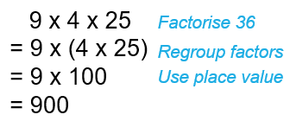
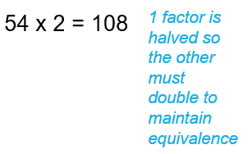
Appropriate, accurate, efficient, flexible strategies
Which property would you apply flexibly as a strategy to mentally calculate the unknown in each of following?
Communicate your strategy for making the mental calculation to someone else in the room.
Explain what influenced your selection of strategy for each calculation?
List other calculations for which your strategy would be appropriate, accurate and efficient?
36 x 25 = ?
21 x 21 = ?
54 x 38 = ? x 19

Slide 14
Understanding
Understand why
21 x 21 = 20 x 20 + 2 x 20 + 1
How can we use a known fact like 20 x 20 = 400 to find an unknown fact like 21 x 21?
Transform 20 rows of 20 into 21 rows of 21.
400 + 20 + 20 + 1 = 441

Slide 15
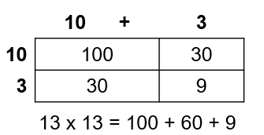
fluency
Students develop understanding and fluency with properties and principles using numerical examples that can be modelled, generalised and used flexibly as mental and written calculation strategies prior to representing and applying them algebraically.
Use your knowledge of 10 x 10 to calculate:
11 x 11
12 x 12
13 x 13
= 100 + 2 x 10 + 1 x 1
= 100 + 4 x 10 + 2 x 2
= 100 + 6 x 10 + 3 x 3
Prompt: draw a sketch, write an equivalent number sentence or visualise the additional rows and columns and what is needed to complete the square.
What number is represented by ? In:
13 x 13 = (10 x 13) + (? x 13)
How do you know?
${(a+b)}^{2}$ = $a^{2}$ + 2ab + $b^{2}$
a(b + c) = ab + ac

Slide 16
THE properties of the numbers in the questions matter!
Skillfully select number relations that will prompt students to use a range of multiplicative strategies.
Skillfully craft multiple examples suitable for practicing and mastering particular strategies. Select numbers with properties that capture the efficiency and appropriateness of a strategy in powerful ways.
Refer to properties of numbers, and relations between them, when justifying the selection of strategy.
1. Teacher
What numbers work well for comparing and contrasting factorisation, an area model, mental distribution and algorithm?
36 x 25 = ?
2. Teacher
Students need to practice using factorisation to make mental calculations, so I need to create situations where one or more numbers are composite and can be rearranged and regrouped in powerful ways to aid mental calculation
17 x 43 = ?
21 x 21 = ?
3. Student
I used factorisation because 36 is divisible by 4 and I can regroup 4 x 25 to make hundreds (communicate thinking coherently and clearly)!

Slide 17
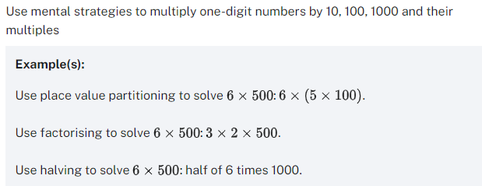
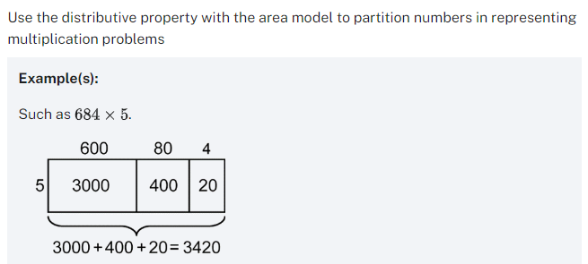
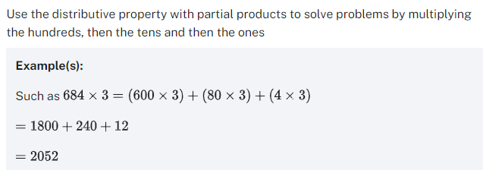
Develop fluency in stage 3 PART A
Stage 3 builds on the foundation of fluency with the properties and multiplication facts to 10 x 10 by applying them to multiply and divide multi-digit numbers by single digits.
Distributive property
Associative property
Distributive property
Associative property

Slide 18
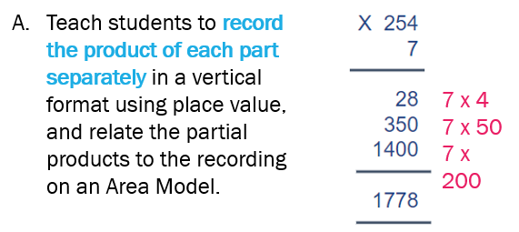
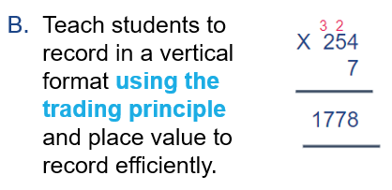
introduce formal algorithms with understanding
Fluency with using the Associative and Distributive properties of multiplication to multiply multi-digit numbers by single digits, indicates readiness for the introduction of the multiplication algorithm.
Use an algorithm with understanding first to connect procedural knowledge to the diagrammatic representation of the Area Model and partial products, before moving to the contracted form of the algorithm. For example, to calculate the product of 7 x 254:
Transform
and
into
then

Slide 19
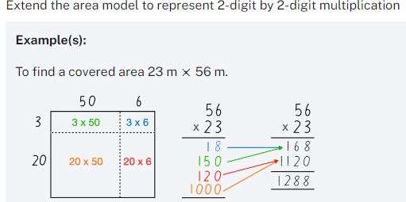
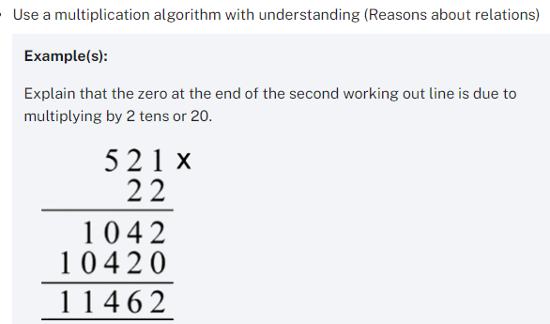
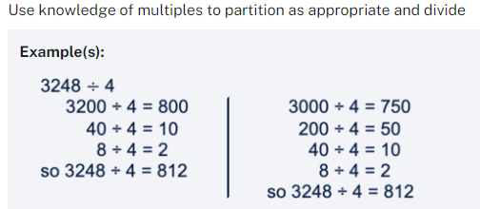
further develop fluency in Stage 3 PART A
… and then by 2-digit multipliers.
Associative property
Distributive property
Associative property
Distributive property
Associative property
Distributive property applied to division: partitioning the dividend
Distributive property

Slide 20
Fluency by the end of Stage 3
Fluency by the end of Stage 3 means ‘knowing to’: selecting and using efficient strategies to multiply multi-digit numbers; using multiplicative relationships to solve rate problems, applying strategies to multiply decimals by single digits and powers of 10 and finding unknown numbers in equivalent number sentences.
This includes understanding the constant quotient principle: to maintain the same quotient, both the dividend and the divisor need to be multiplied or divided by the same factor: 120 ÷ 30 = 12 ÷ 3. Understanding this principle is the foundation for identifying fractional equivalences.
Which properties and principles would you apply flexibly to solve each question efficiently, accurately, appropriately?
16 x 125 = ?
8 x 250
19 x 19 = ?
20 x 20 – 2 x 20 + 1
21 x 40 = ?
(21 x 4) x 10
2700 ÷ 90 = ? ÷ 9
270 ÷ 9
22 x ? = 38 x 11
(7 x 20) + (7 x 4)
22 x 19 = 38 x 11
7 x 24 = ?

Slide 21
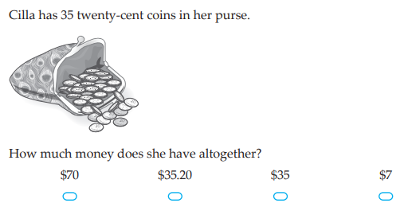
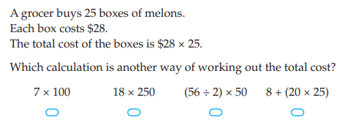
Solve multiplication word problems
Provide a range of routine and non-routine problems that require students to apply properties. Students need many experiences to relate their knowledge to the vocabulary and conceptual frameworks of mathematics. Select contexts, language, diagrams, numbers and relationships that offer insight into reasoning as well as knowledge of facts and procedures. Include non-routine problems that involve sequencing multiple steps.
A great multi-step problem drawing on knowledge of mass measurement units and numerical relationships. After solving this problem, students might benefit from taking Polya’s advice and solving it again a better
A nice problem for multiplying multiples of 10 or applying the Associative property, e.g. 35 x 20 = 7 x 5 x 20 = 7 x $1.
A nice example of a question that directly targets understanding and recognising the Associative property.

Slide 22
Developing understanding and Fluency
a STRATEGIC balancing act!
Dr Christine Mae Mobile: 0433 700 946 Email: christinemae583@gmail.com

