Slide 1
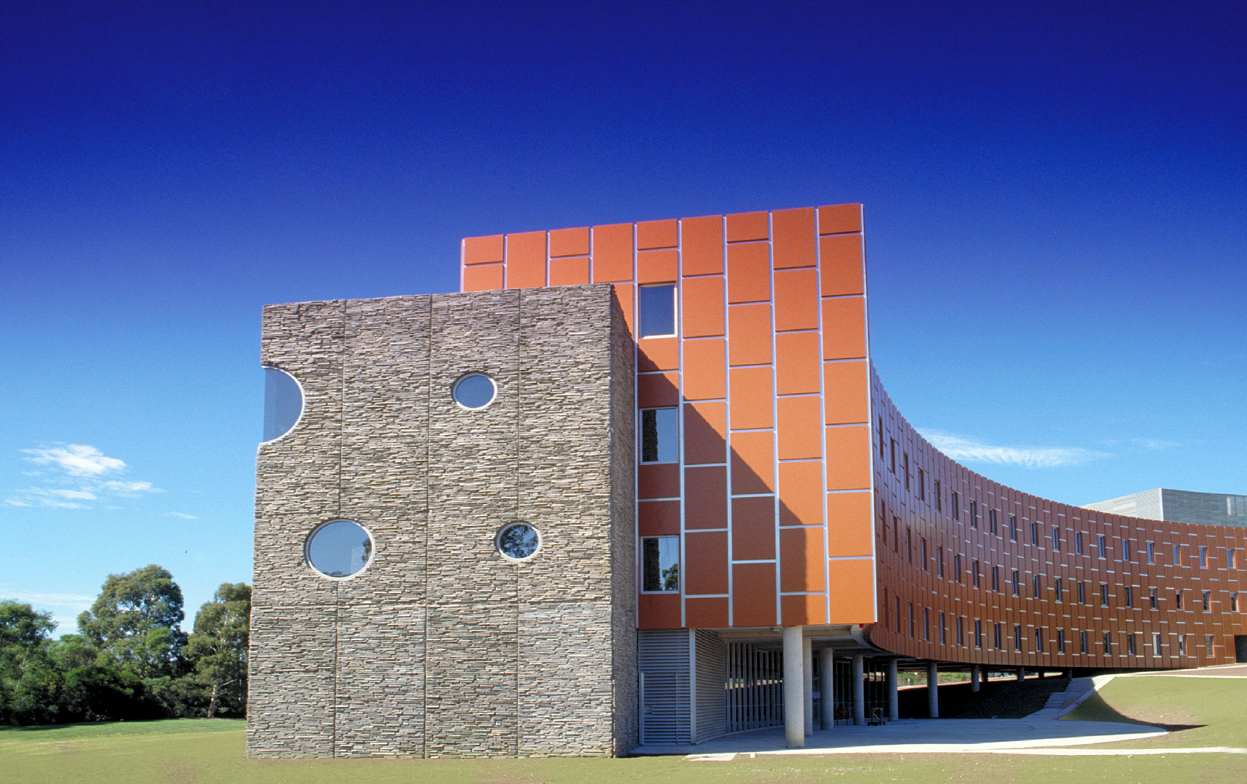
MAKING CONNECTIONS: WORKING MATHEMATICALLY
A professional learning workshop by Emeritus Professor Dianne Siemon
RMIT University

Slide 2
Mathematical Proficiency – The ultimate Goal
Conceptual understanding: Comprehension of mathematical concepts, operations, and relations
Strategic competence: Ability to formulate, represent, and solve mathematical problems
Productive disposition: Habitual inclination to see mathematics as sensible, useful, and worthwhile, coupled with a belief in diligence and one’s own efficacy
Adaptive reasoning: Capacity for logical thought, reflection, explanation, and justification
Procedural fluency: Skill in carrying our procedures flexibly, accurately, efficiently, and appropriately
Kilpatrick, J., Swafford, J. & Findell, B. (Eds.) (2001). Adding it up: Helping children learn mathematics. Washington DC: National Academy Press

Slide 3
TIMSS 2019 Australian Results – Year 4
Advanced International Benchmark | Students can apply their understanding and knowledge in a variety of relatively complex situations and explain their reasoning. Students can solve a variety of multistep word problems involving whole numbers and show an understanding of fractions and decimals. They can apply knowledge of two- and three- dimensional shapes in a variety of situations. Students can interpret and represent data to solve multistep problems. | 10%
High International Benchmark | Students apply conceptual understanding to solve problems. They can apply conceptual understanding of whole numbers to solve two-step word problems. They show understanding of the number line, multiples, factors and rounding numbers, and operations with fractions and decimals. Students can solve simple measurement problems. They demonstrate understanding of geometric properties of shapes and angles. Students can interpret and use data in tables and a variety of graphs to solve problems. | 26%
Intermediate International Benchmark | Students can apply basic mathematical knowledge in simple situations. They can compute with three- and four-digit whole numbers in a variety of situations. They have some understanding of decimals and fractions. Students can identify and draw shapes with simple properties. They can read, label and interpret information in graphs and tables. | 34%
Low International Benchmark | Students have some basic mathematical knowledge. They can add, subtract, multiply, and divide one- and two-digit whole numbers. They can solve simple word problems. They have some knowledge of simple fractions and common geometric shapes. Students can read and complete simple bar graphs and tables. | 20%
Thompson et al., 2019

Slide 4
TIMSS 2019 Australian Results – Year 8
Advanced International Benchmark | Students can apply and reason in a variety of problem situations, solve linear equations and make generalisations. They can solve a variety of fraction, proportion, and percentage problems and justify their conclusions. They can understand linear functions and algebraic expressions. Students can use their knowledge of geometric figures to solve a wide range of problems involving angles, area, and surface area. They can calculate means and medians, and understand how changing data points can impact the mean. Students can interpret a wide variety of data displays to draw and justify conclusions, and solve multistep problems. They can solve problems involving expected values. | 11%
High International Benchmark | Students can apply their understanding and knowledge in a variety of relatively complex situations. They can solve problems with fractions, decimals, ratios and proportions. Students at this level show basic procedural knowledge related to algebraic expressions and equations. They can solve a variety of problems with angles, including problems involving triangles, parallel lines, rectangles and congruent and similar figures. Students can interpret data in a variety of graphs and solve simple problems involving outcomes and probabilities. | 25%
Intermediate International Benchmark | Students can apply basic mathematical knowledge in a variety of situations. They can solve problems involving whole numbers, negative numbers, fractions, decimals and ratios. Students have some basic knowledge about properties of two-dimensional shapes. They can read and interpret data in graphs and have some rudimentary knowledge of probability. | 32%
Low International Benchmark | Students have some knowledge of whole numbers and basic graphs. | 22%
Thompson et al., 2019

Slide 5

Working Mathematically in the NSW Syllabus – Four Processes:
Communicating
Understanding and Fluency
Reasoning
Problem Solving
One overarching Working mathematically outcome.
A student develops understanding and fluency in mathematics through:
exploring and connecting mathematical concepts
choosing and applying mathematical techniques to solve problems
communicating their thinking and reasoning coherently and clearly.
Working Mathematically Elaboration, July 2023 (Emphasis added)

Slide 6
Exploring and connecting mathematical concepts
Sharing & Composite Units (F-)
Doubling (Yr1-)
‘Array’ idea for multiplication (Yr2-)
Halving (Yr1-)
Fractions (Yr1-)
Thirding (Yr2-)
(equi)Partitioning
‘For each’ for multiplication (Yr2-)
Fifthing (Yr3-)
Tenthing (Yr4-)
Factors (Yr4-)
Decimal Fractions (Yr4-)
Equivalent Fractions (Yr5-)
Proportional Reasoning
© Dianne Siemon 6

Slide 7
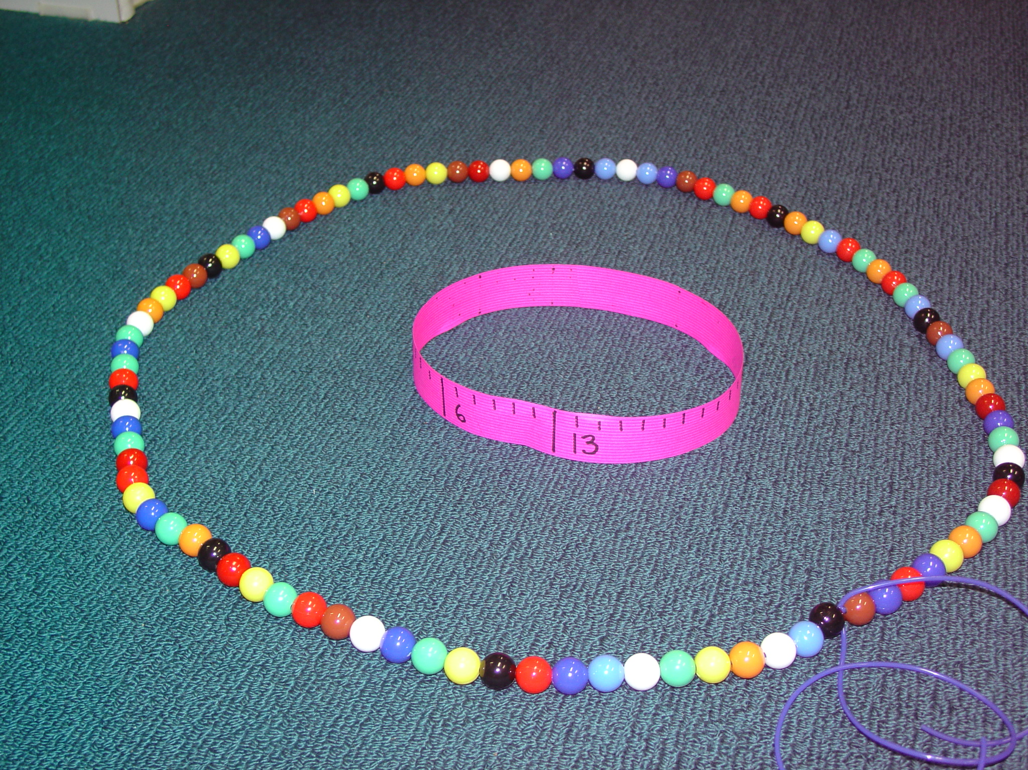
‘This Goes With That’
An activity that explores data representation, proportion and percent
Collect survey data (e.g., favourite sport, fast food, type of television program, …)
Discuss how this might be represented and communicated
Make a strip graph by deciding on a scale (e.g., 3 cm = 1 vote), join the ends to make a circle then use a 100-bead circle to ….
What possibilities are there?
From Maths300
© Dianne Siemon 7

Slide 8
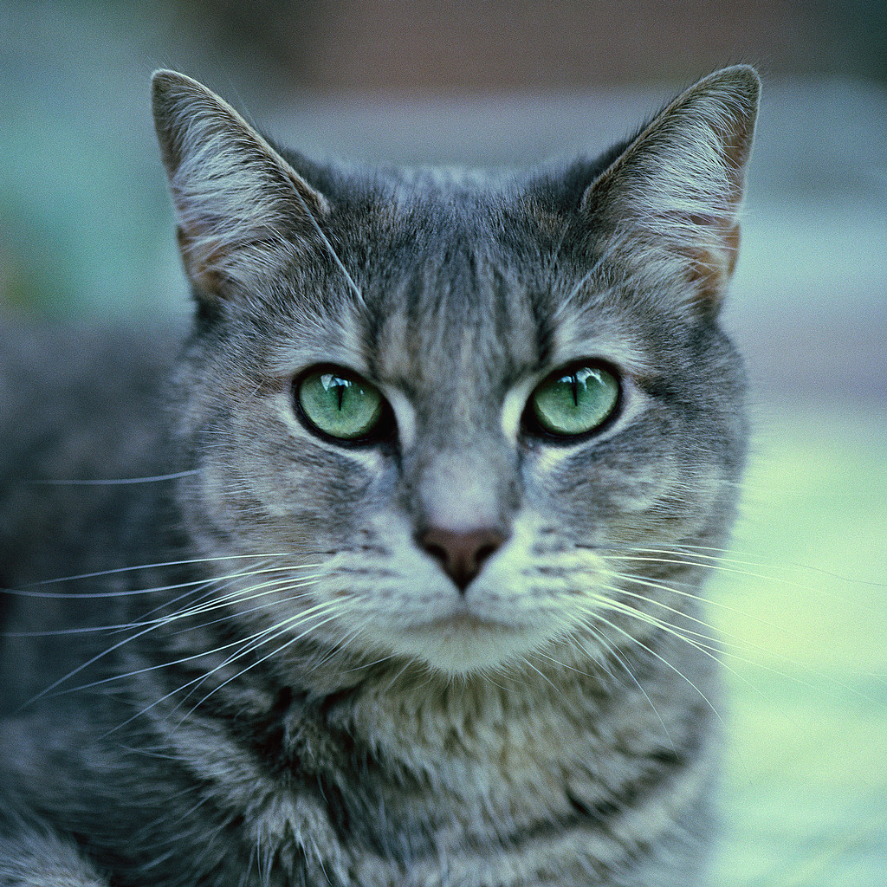
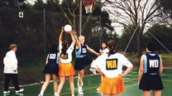
Choosing and applying mathematical techniques to solve problems
Thirty-five feral cats were estimated to live in a 146 hectare nature reserve.
Twenty-seven feral cats were estimated to live in another nature reserve of 103 hectares.
Which reserve had the biggest feral cat problem?
Ariana had a goal-shooting average of 12 goals before the finals? In the semi-final she scored 18 goals and in the final she scored 15 goals. What was her end-of-season average?
© Dianne Siemon 8

Slide 9
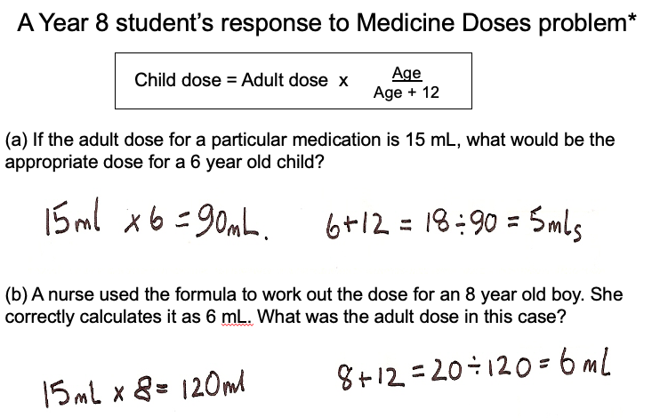
Communicating and reasoning coherently
* Task from Beesey et al (1998), data from MYNRP (Siemon et al, 2001)
© Dianne Siemon 9

Slide 10
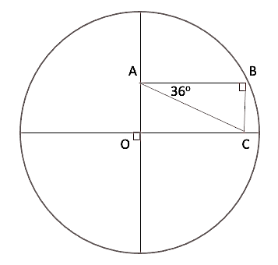
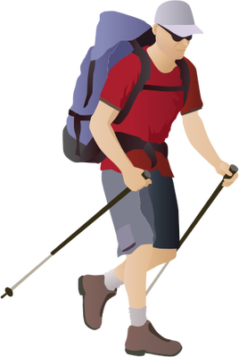
What is involved in solving the following? problems?
O is the centre of a circle of diameter 17 cm. ABC is a right triangle and the line BC is 5 cm long. What is the length of the line AC?
Find the area of the shaded part if the diameter of the circle is 22 cm and ABCD is a square
A B
C D
A
O
C
A hiker walked 3 km North, 5 km South-West then 2 km East. Where was he in relation to his starting point ?
© Dianne Siemon 10

Slide 11

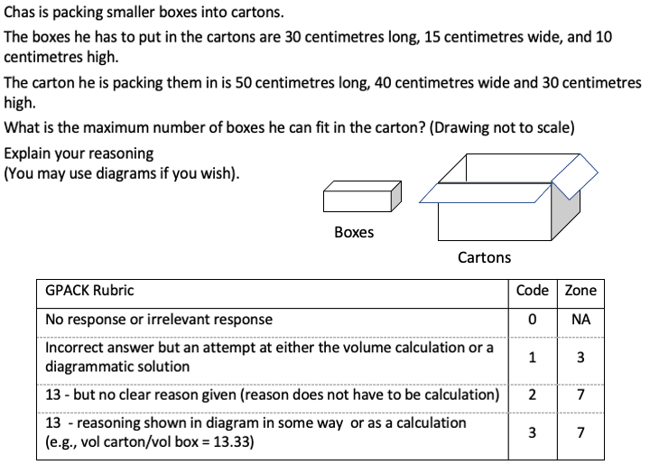
© Dianne Siemon 11

Slide 12
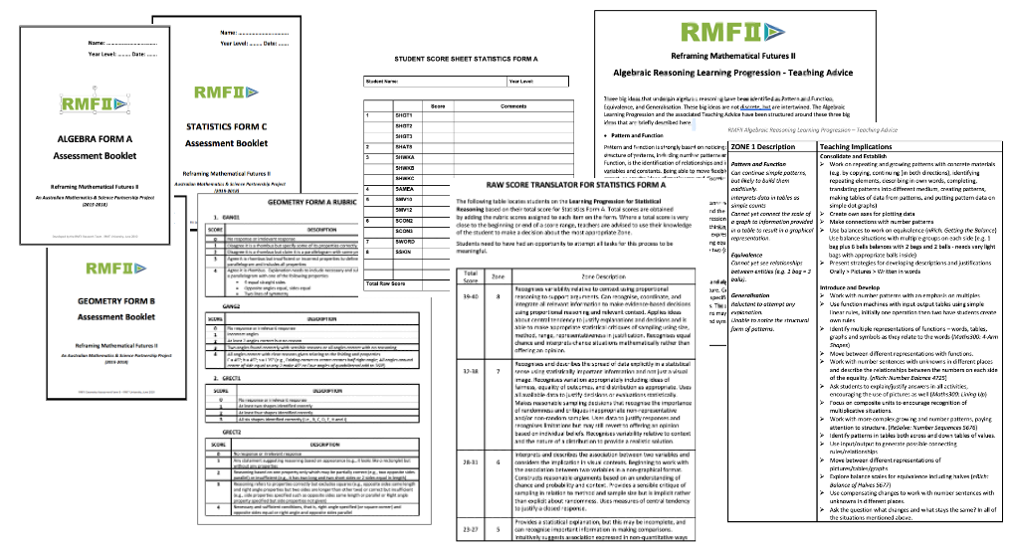
RMFII Mathematical Reasoning Resources
http://www.mathseducation.org.au
© Dianne Siemon 12

Slide 13
Problem Solving in the Australian Curriculum: Mathematics (v.9.0)
Students engage in mathematical problem solving when:
they are presented with a problem situation for which they do not immediately know the answer,
formulate situations mathematically,
work through a process of planning,
draw on previously learnt concepts, skills, procedures, and processes,
evaluate and communicate solutions, and
justify the reasonableness of their approaches in terms of the situation.
© Dianne Siemon 13

Slide 14
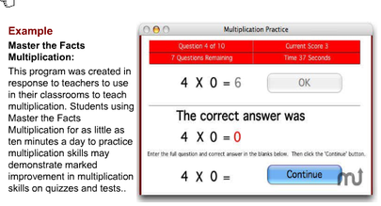
Problem Solving?
Computer Programs/Apps
© Dianne Siemon 14

Slide 15
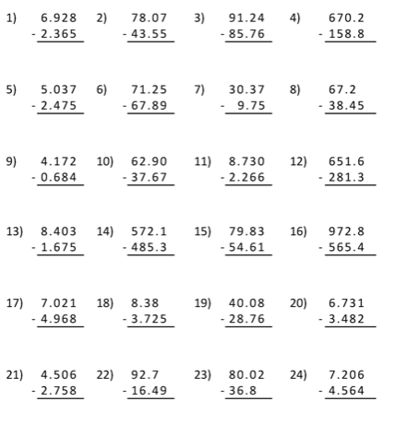
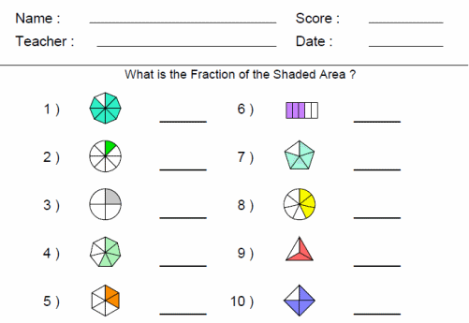
Problem Solving?
Work Sheets?
© Dianne Siemon 15

Slide 16
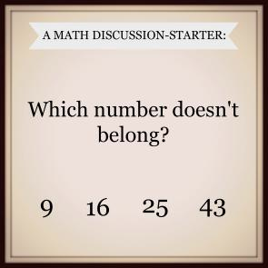
Problem Solving?
Note your first response …
Share with a neighbour.
What do you notice?
Rich Task?
edublog.scholastic.com
© Dianne Siemon 16
Notes:
9 because digits do not add to 7, 9 because it is only single digit number, 43 because it is only prime number, 43 because it is not a square number, 16 because it is the only even number, 25 because …? Digit in the one’s place is not a multiple of 3

Slide 17
Problem Solving
The totality of processes engaged in by a group or individual in an attempt to negotiate a satisfactory resolution to a situation, task or question for which there was no immediately available, valid solution strategy or procedure at the outset.
(Siemon, 1993)
© Dianne Siemon 17

Slide 18
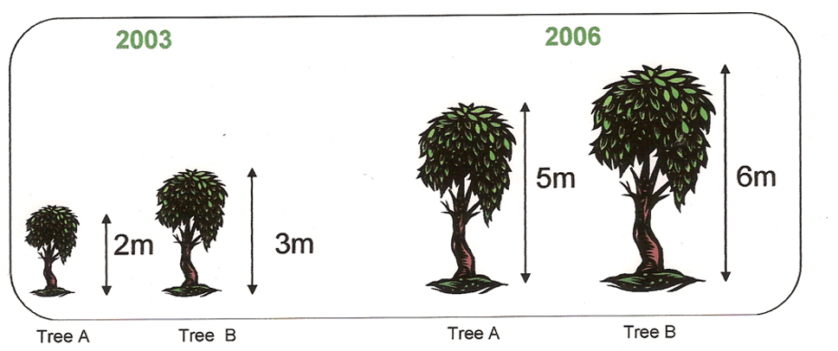
What is the problem with problem solving?
Which tree grew more?
Please show your working and/or explain your thinking.
Who had the most pizza?
Please show your working and/or explain your thinking.
12 girls share 7 pizzas
20 boys share 11 pizzas
Who gets more pizza per person, the girls or the boys?
 | Rock Wall | Canoeing | Archery | Ropes Course
Year 5 | 15 | 18 | 24 | 18
Year 7 | 19 | 21 | 38 | 22
Camp Reefton Thursday Activities
Do you agree with the Manager?
© Dianne Siemon 18

Slide 19
Which of these is the longest distance?
0.1203 km 123 m 1230 cm 12 030 mm
Helen has 24 red apples and 12 green apples. What fraction of the apples are green?
1 1 1 1
2 3 4 12
A copier prints 1200 leaflets.
One-third of the leaflets are on yellow paper and the rest are on blue paper. There are smudges on 5% of the blue leaflets.
How many blue leaflets have smudges?
40 60 400 800
From Sample Year 9 NAPLAN Test, ACARA

Slide 20
Problem solving as an endeavour requires the co-ordination of reflection and activity
(Hatfield, 1979, p. xiii)
© Dianne Siemon 20

Slide 21
The role of metacognition
DIVERS
High Conceptual-Low Procedural
SOLVERS
High Conceptual-High Procedural
Conceptual Knowledge
SURVIVORS
Low Conceptual-Low Procedural
PLAYERS
Low Conceptual-High Procedural
Procedural Knowledge
Meta-Model of Children’s Approaches to Mathematical Problem Solving (Siemon, 1993)

Slide 22
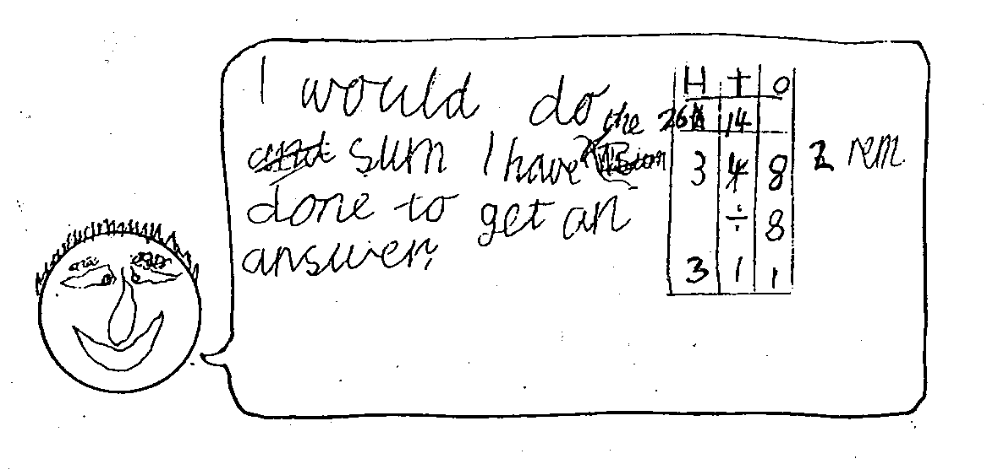
A ‘Player’:
Eight families shared a Tattslotto win of $348. How much did each family receive? (Year 4)
Nick’s ‘Talking Head’ response (Siemon, 1993)
© Dianne Siemon 22

Slide 23
A ‘Survivor’:
Richard’s solution strategy for 19 + 27
19
+ 27
31
43
424
46
Can you identify Richard’s strategy?
What does this response say about what Richard knows and values?
Richard is in Year 6
© Dianne Siemon 23

Slide 24
A Problem?
A scientist has a collection of beetles and spiders in a special container. The floor sensor tells her that there are 174 legs altogether and the infra-red detector tells her that there are 26 bodies. How many are beetles and how many are spiders?
© Dianne Siemon 24

Slide 25
Problem
No immediately available solution strategy
PROBLEM TYPE
Process
Strategies
Re read the problem, record the data, what is required, UNDERSTAND
THINK about the problem, have I seen something like this before
TRY something
CHECK to see if it worked or not, does it satisfy the problem conditions
Guess and check Trial and error
Make a model
Draw a diagram
Use equations
If … then reasoning
Table of values
© Dianne Siemon 25

Slide 26
Problem Type
Recognising problem type and/or structure can help identify an appropriate solution strategy.
Problems can vary according to:
the nature (transparency) of the information provided,
the extent (amount) of information provided,
the number of steps involved, and
the underlying structure.
12 strawberry plants per row, 18 rows, how many plants?
Part | Part
Whole
M₁ | M₂
1 | 12
18 | ?
Additive Structure
Multiplicative Structure
© Dianne Siemon 26

Slide 27
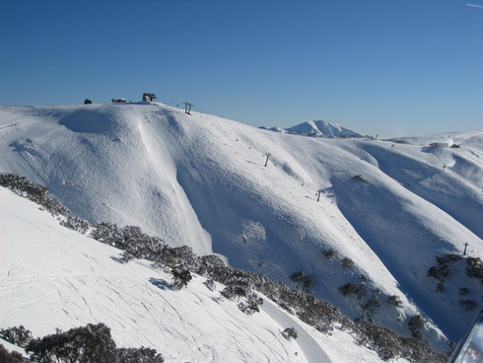
For example,
What is involved in solving the following?
Connie’s parents drove to Sydney via the Alpine Way, a distance of 1093 kilometres. They left at 8 am and averaged 86km/hr for the first 4 hours of their journey. They stopped for lunch for 1 hours and then they drove for another 3 hours at an average speed of 78 km/hr before stopping for the night.
How far had they travelled?
© Dianne Siemon 27

Slide 28
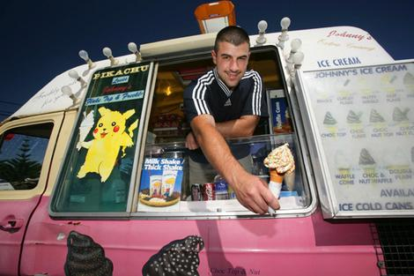
Ice-cream problem
Grace had a $5 note in her pocket. She bought a chocolate ice-cream from the ice-cream van. How much change did she receive?
single | double | triple
$2.30 | $3.50 | $4.60
Marbles
Tim had three bags of marbles. There were 8 marbles in each bag. How many marbles did he have altogether?
Google Images
Sam and Joseph
Sam and Joseph each had a shorter sister, and they argued about who was taller than his sister. Sam won the argument by 14 centimeters. He was 186 cm tall; his sister was 87 cm; and Joseph was 193 cm tall.
How tall was Joseph’s sister?
(adapted from Thompson, 1993)
© Dianne Siemon 28

Slide 29
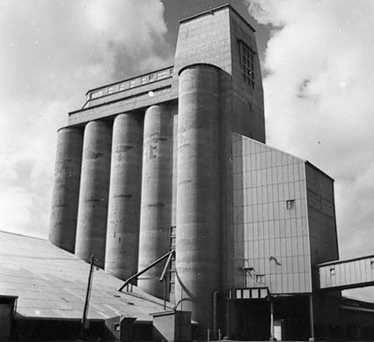
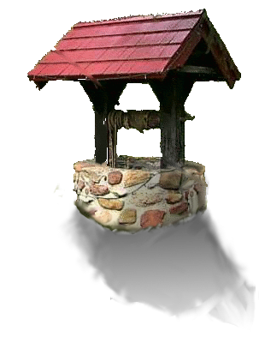
Loading wheat
25 silos hold 60,000 tonnes of wheat which is pumped into ships at 800 tonnes per hour. If it costs $84 per hour for pumping, what is the cost of emptying 1 silo of wheat?
Freddy Frog
Freddy Frog dived into a well that was 12 metres deep. Unfortunately, the well was empty.
Each day he climbed 4 metres up the side of the well. Each night he slid down 2 metres.
How many days did it take Freddy to get out of the well?
Google Images
© Dianne Siemon 29

Slide 30
Process
Polya’s (1945) Model for effective Problem Solving
Understanding the Problem
Devising a Plan
Carrying out the Plan
Looking Back
Use one ball of play dough to represent 7 quarters.
You must use the entire ball.
© Dianne Siemon 30

Slide 31

The ASK-THINK-DO Problem Solving Cycle
Questions we can ASK
What is the problems asking?
What do we need to find?
What information is given?
What do we need to know?
Does it make sense?
How could we check?
Have we forgotten anything?
Can we do it another way?
Things we can THINK about
Have I seen anything like this before?
How can I represent the problem?
Is it a part, or is it a whole?
What do I know?
Is there a similar problem we could use?
How can I organise the information?
What happened first?
What needs to be done next?
Does it make sense?
What is not needed?
What is it likely to be?
What do we need to do?
Things we can DO
Make a list.
Record data.
Draw a diagram.
Check information
Re-read the problem
Make a model
Use a simpler or similar problem.
Classify, Order, Compare.
Estimate
Work backwards.
Eliminate options.
Add, subtract, multiply, divide
(Siemon, 1986, 1993)

Slide 32
Strategies
1. Draw a picture.
2. Restate the problem.
3. Classify or order data.
4. Act it out.
5. Ask. "Is it a part or is it a whole?"
6. Record data
7. Estimate
8. Use a pattern
9. Make a model
10. Experiment
11. Use a simpler problem
12. Make a table
Butterflies
2 drops of nectar are needed to feed 5 butterflies. How many butterflies could be fed with 12 drops of nectar? How many drops of nectar are needed to feed 63 butterflies?
13. Draw a graph
14. Make a list
15. Eliminate options
16. Assume a solution and work backwards
17. Use symbols
18. Write an equation
© Dianne Siemon 32

Slide 33
Horizon Problems:
draw on content at higher levels of the curriculum to provide an engaging but challenging task
presented in an interesting and accessible context that allows all learners to make a start;
provide opportunities for ‘teaching moments’ and insights into student understanding and strategies.
© Dianne Siemon 33

Slide 34
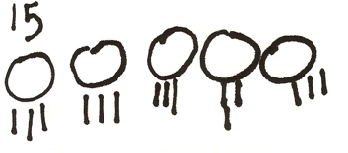
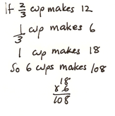
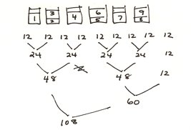
For example,
Foundation - Baa-Baa Black Sheep Problem
Year 4 - Muffin Problem
© Dianne Siemon 34

Slide 35
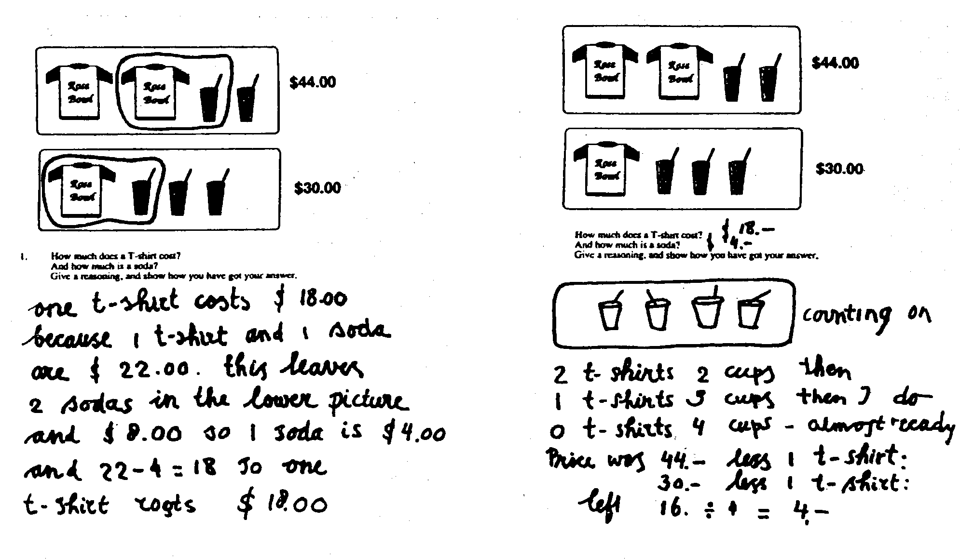
Year 6 – Jan’s T-Shirt Problem
(De Lange,1996)

Slide 36
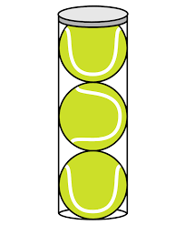
True or False? Convince me!
1
3
2
7
Is a can of tennis balls higher than it is around?
is smaller than
2
5
is larger than
5
12
24 x 21 = 42 x 12
0.6 < 0.63 < 0.635
4.8 > 4.79 > 4.729
What could be learnt from student responses?
© Dianne Siemon 36

Slide 37
Open-ended Questions:
require more than remembering a fact or reproducing a skill;
have several acceptable answers;
engage learners of different abilities;
enable students to learn by answering the question; and
the teacher to learn about each pupil from the attempt.
(Sullivan & Lilburn, 1997)

Slide 38
For example,
John and Maria each measured the length of the basketball court. John said that it was 20 rulers long and Maria said it was 19½ rulers long. How could this happen?
In my pocket I have $36. what notes and coins might I have?
Can you find three fractions between 1 half and 3 quarters?
(Sullivan & Lilburn, 1997)

Slide 39
Rich Tasks:
involve important mathematics from more than one area of the mathematics curriculum;
connect to a real-world context, problem, question or issue of interest to students;
generally involve some data collection, analysis, conjecture, evaluation and result in some sort of product or outcome;
provide opportunities for working mathematically and making problem solving explicit; and
can be used over a number of Year levels.
© Dianne Siemon 39

Slide 40
For example,
Rubbish: How much rubbish does this grade produce in a school year?
Bird-seed: Using 1 sheet of A4 paper only and some sticky tape, make a container to hold bird-seed. What sort of container will hold the most bird-seed when filled to the top? What will hold the least amount?
Danger Distance: How far away does an on-coming car need to be before you should cross the road?
Money Trail: As a fundraiser, let’s build a money trail of 20c coins from the classroom to the front gate. How much would it be worth?
(Lovitt & Clarke, 1988)

Slide 41
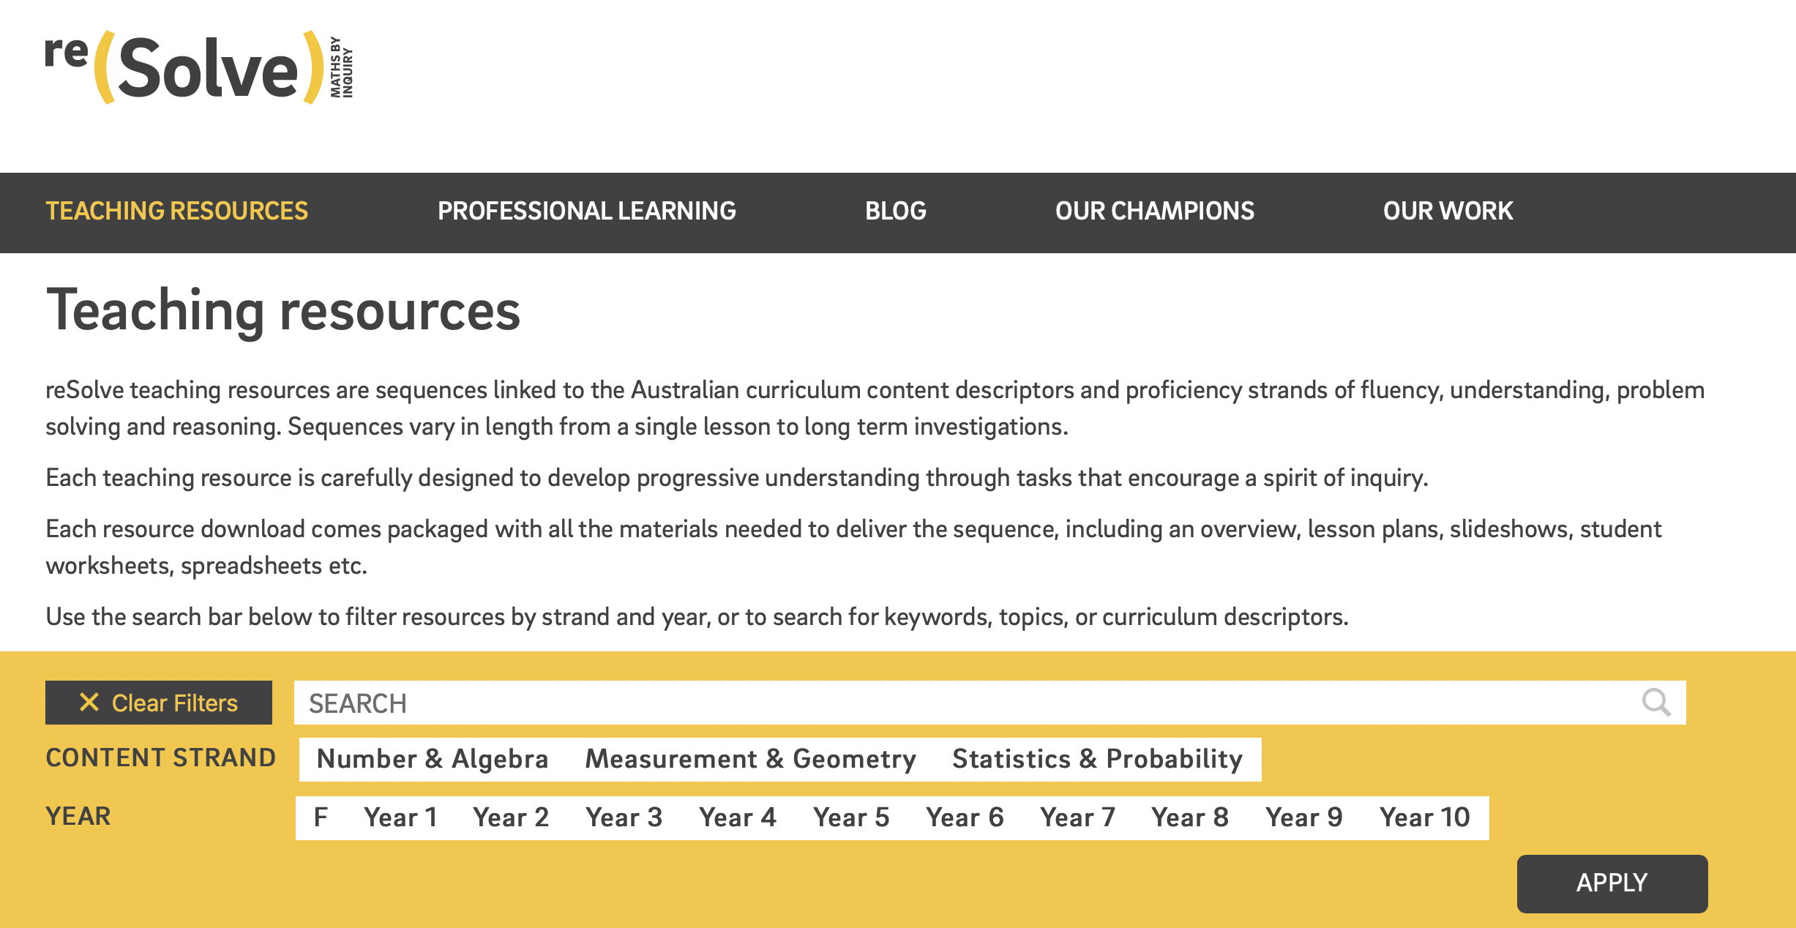
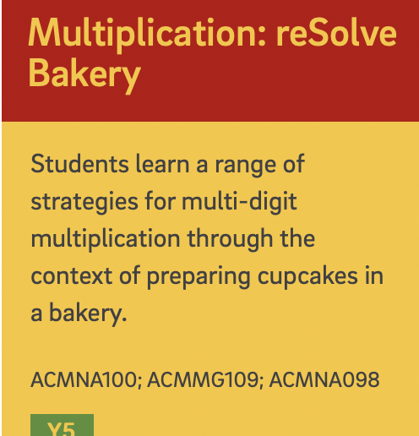
From reSolve – promoting a spirit of inquiry
From: reSolve, https://www.resolve.edu.au

Slide 42
Fermi Questions
Fermi was an Italian physicist who demonstrated the power of using estimation to address seemingly unanswerable questions, such as ‘How many piano tuners in New York?”
Fermi questions:
draw upon everyday experience, allow most students to make a start, encourage multiple approaches;
develop number sense, computational fluency, problem-solving, modelling, and estimation skills;
help build a sense of community and mathematical confidence through discussion and justification of solution strategies
Taggert, G., Adams, P., Elitze, E., Heinrichs, J., Hohman, J. & Hickman, K. (2007). Fermi Questions. Mathematics Teaching in the Middle School, 13(3), 164-167
© Dianne Siemon 42

Slide 43
Some examples
How many drops of water are there in Lake Hume?*
How many balloons will it take to fill the school hall?*
How many pallets of bottled water (500 mL) were consumed by fire-fighters in the fires of 2006/7?*
How much water is lost by uncovered swimming pools in Melbourne on Boxing Day?
How many deer are there in the Dandenong Ranges?
How much money is spent by 15 year-olds per week?
How many people will go without a meal tonight?
* Adapted from Taggert et al (2007)
© Dianne Siemon 43

